Slide 1


Jagan Mohan Batchala
Data Scientist
https://github.com/jaganmohanbatchala
https://www.linkedin.com/in/jaganmohanb/
www.jaganinfo.com

Slide 2
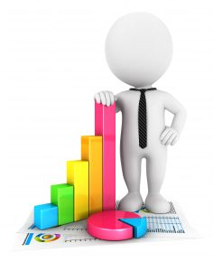
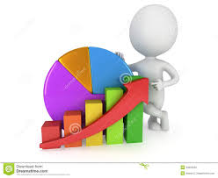
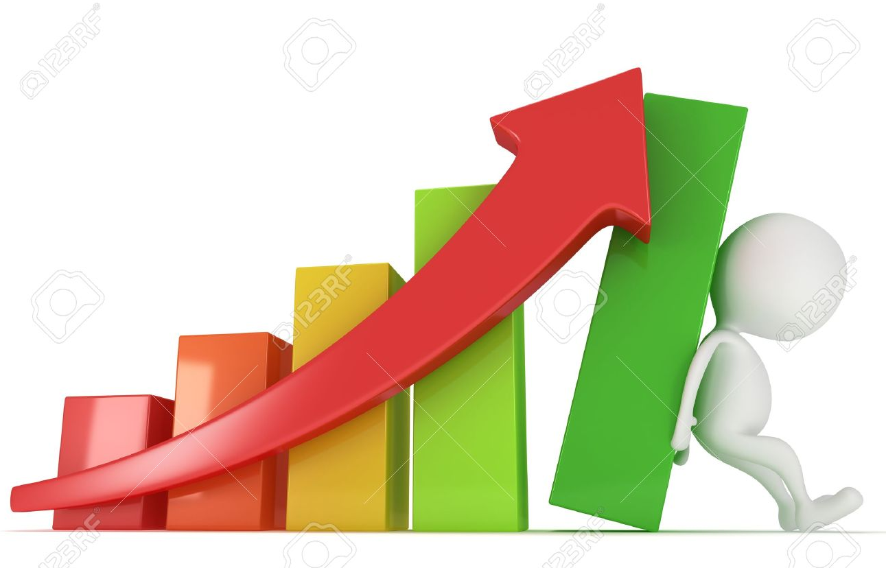
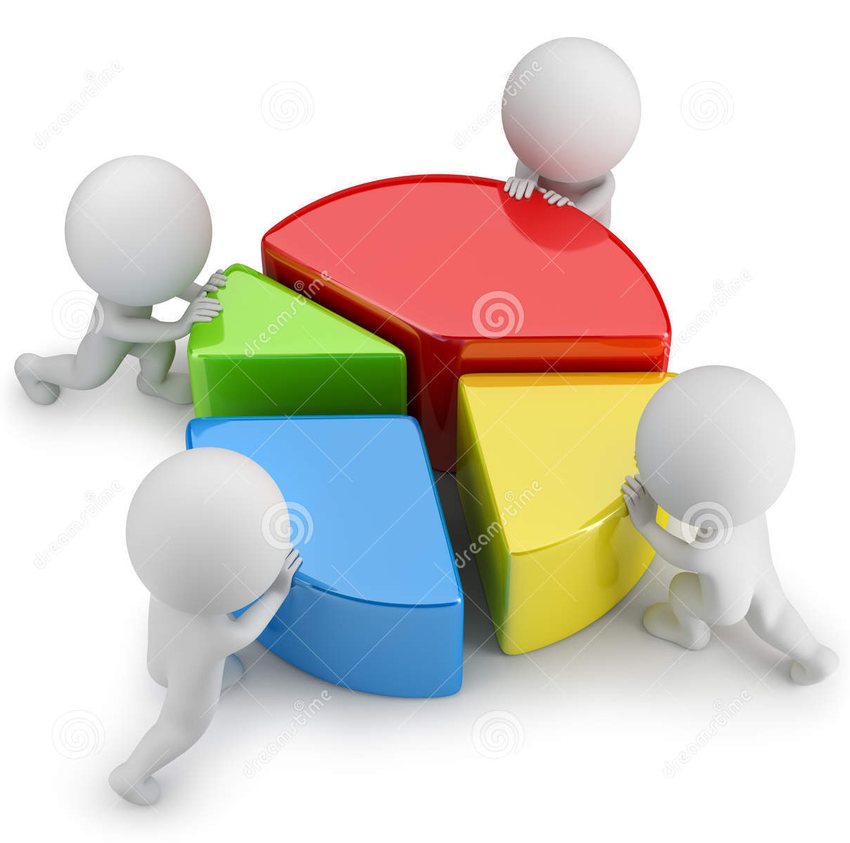
Data Visualization
Usage of Python Visualisation Libraries

Slide 3
VISUALS ADD A COMPONENT TO STORYTELLING THAT TEXT CANNOT | SPEED.
FACT
Images are another element that can drive your point home even more

Slide 4
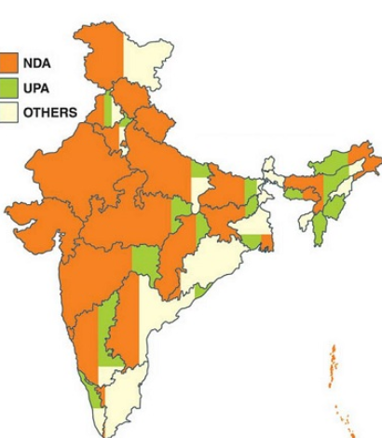
Politics: This visualization depicts the rule of elected government in respective states of India. See, how effortlessly, it can be easily analyzed that prominence of NDA government prevails over other two parties in India.

Slide 5
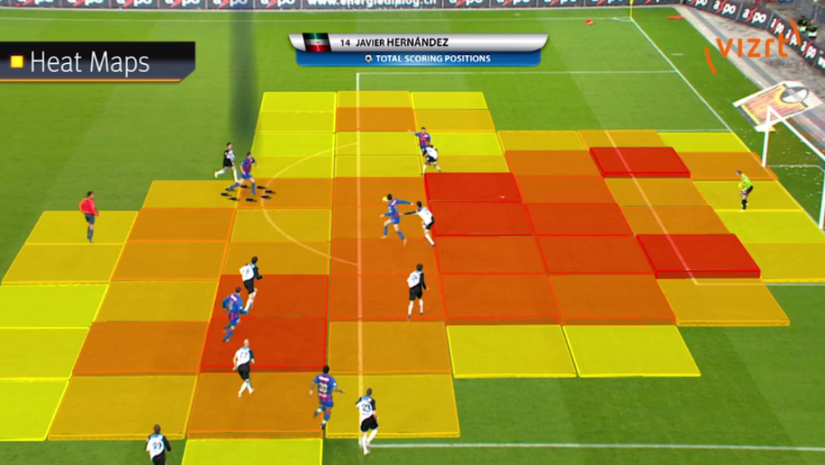
Sports Analytics: In last 5 years, sports broadcasting channels have improved a lot to convey information. They have high bar on visualization and these techniques convey the right information to the audience by just glancing through them for fraction of seconds. In the visualization shown below, you can infer the areas where a player scores most of his goals from.

Slide 6

Visualization \ Visualisation
It is any technique for creating images, diagrams, or animations to communicate a message.
Is Data scientist an artist ?
Data Sculpting to Shape Business Insights
They make paintings in form of digital visualization (of data)
with a motive of manifesting the hidden patterns / insights in it.

Slide 7
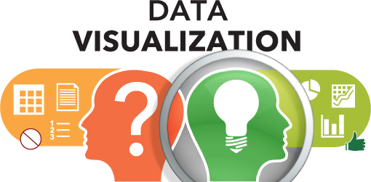
Types of data visualizations
Explanatory
The aim of explanatory visualizations is to tell stories—they’re carefully constructed to surface key findings.
Exploratory
Create an interface into a dataset … they facilitate the user exploring the data, letting them unearth their own insights.
Exploratory visualizations are interactive. While there are many Python plotting libraries, only a handful can create interactive charts that you can embed online and distribute.
Collect Data , Visulaize Data , Give Solutions

Slide 8
Role of Visualisation
 | Data Science Flow | Role of Visualisation
Frame | Problem deﬁnition | Structuring (issue tree, hypotheses)
Acquire | Data ingestion | Loading (progress, errors)
Reﬁne | Data wrangling | Proﬁling (missing values, outliers)
Transform | Feature creation | Univariate & Bivariate Vis (1D, 2D)
Explore | Feature selection | Multi Dimensional Vis (3D ... ND)
Model | Model creation & assessment | Model Vis (predictions, errors, models)
Insight | Solution communication | Vis Comm (chart, narrative, dashboard)

Slide 9
Understanding Visualisation
Layer | Examples
Domain & Task Layer | Tabular Data for EDA
Data Layer | Data Types, Transformation
Visual Layer | Encoding, Marks, Coordinate
Annotation Layer | Labels, Ticks, Titles
Model creation & assessment | Model Vis (predictions, errors, models)
Interaction Layer | Filtering, Highlighting, Selection

Slide 10
Choose the Plot
Variable | Data Type | Plot
1 | Numeric | Histogram
1 | Categorical | Barplot
2 | Numeric vs. Numeric | Scatterplot
2 | Numerical vs. Categorical | Boxplot
3 | Color or Shape or facet
3 | Color and/or Shape and/or facet

Slide 11
Python Visualisation Libraries
Matplotlib
Pandas
ggpy
Altair
Seaborn
Plotly
Bokeh
HoloViews
VisPy
Lightning
https://matplotlib.org/
https://pandas.pydata.org/
https://github.com/yhat/ggpy
https://altair-viz.github.io/
https://seaborn.pydata.org/
https://plot.ly/python/
https://bokeh.pydata.org/en/latest/
http://holoviews.org/
http://vispy.org/
http://lightning-viz.org/

Slide 12

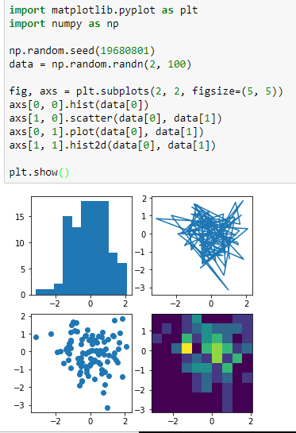
Python Vis Library -
Matplotlib is a Python 2D plotting library which produces publication quality figures in a interactive environments across platforms.
We can generate plots, histograms, power spectra, bar charts, errorcharts, scatterplots, etc., with just a few lines of code
“tries to make easy things easy and
hard things possible”

Slide 13
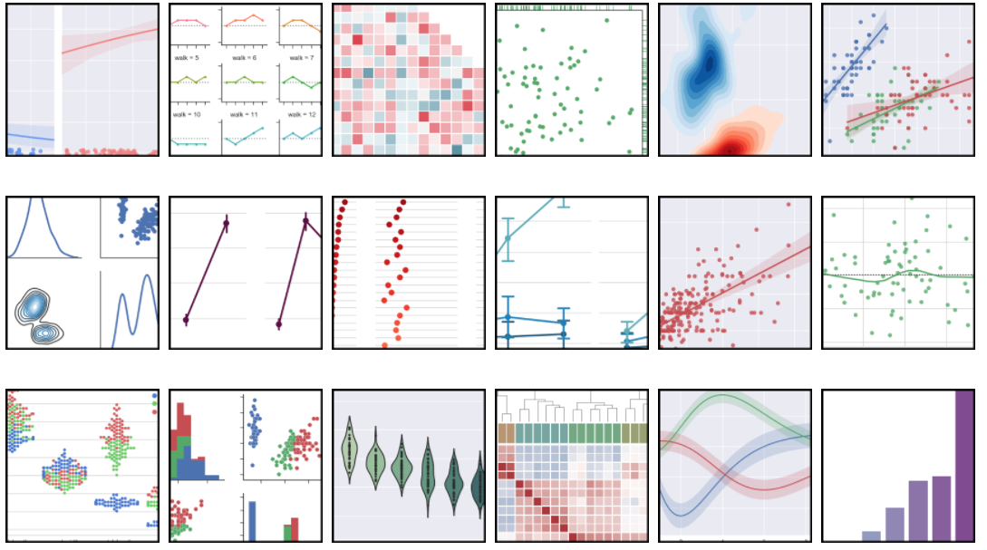
Python Vis Library - seaborn
Seaborn is a library for making attractive and informative statistical graphics in Python.
Seaborn aims to make visualization a central part of exploring and understanding data.
The plotting functions operate on dataframes and internally perform the necessary aggregation and statistical model-fitting to produce informative plots.
“tries to make a well-defined set of
hard things easy too”

Slide 14
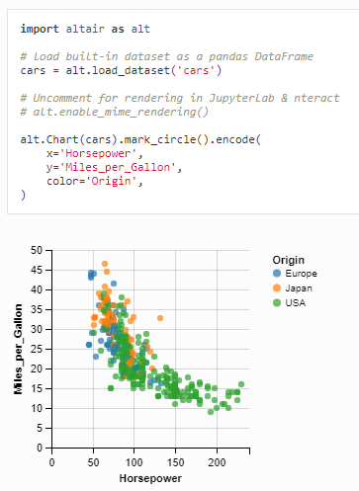
Python Vis Library - Altair
Altair is a declarative statistical visualization library for Python
We can generate plots, histograms, power spectra, bar charts, errorcharts, scatterplots, etc., with just a few lines of code
* Altair is still in development phase
“produces beautiful and effective visualizations with a minimal amount of code”

Slide 15
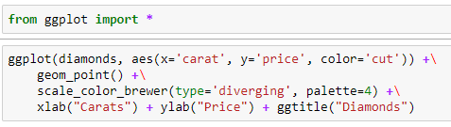
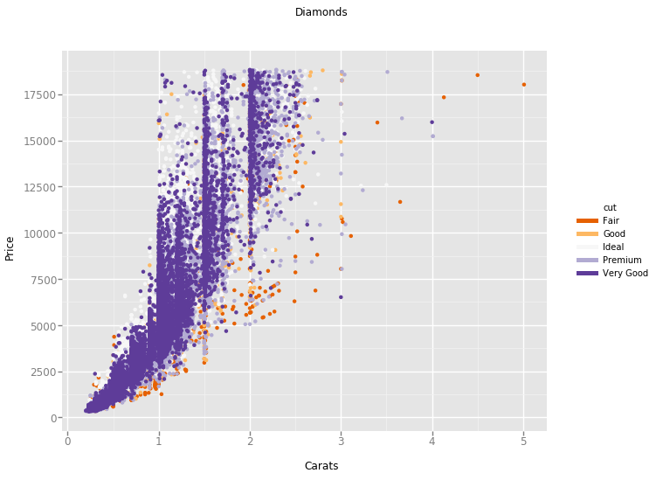
Python Vis Library – ggplot from ŷhat
* Alteryx Acquires Yhat
“ggplot is easy to learn ggplot is fun ggplot is powerful”

Slide 16
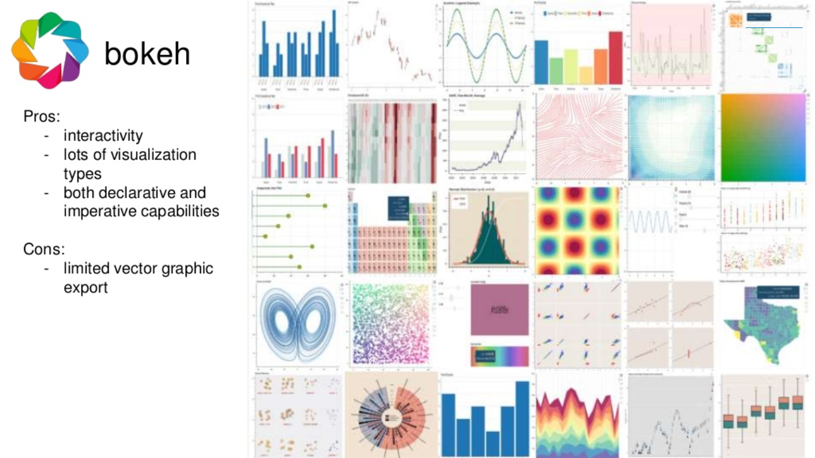

Slide 17
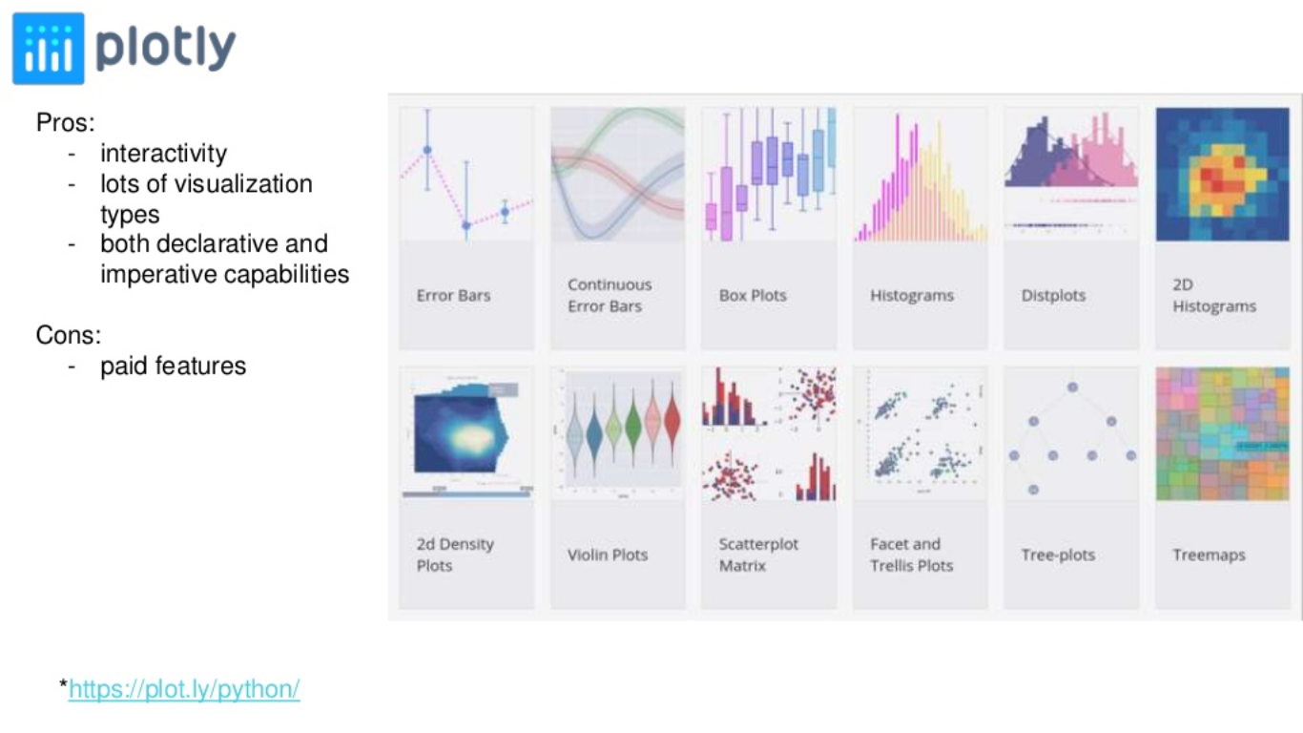

Slide 18
Pandas is handy for simple plots but you need to be willing to learn matplotlib to customize.
Seaborn can support some more complex visualization approaches but still requires matplotlib knowledge to tweak. The color schemes are a nice bonus.
ggplot has a lot of promise but is still going through growing pains.
bokeh is a robust tool if you want to set up your own visualization server but may be overkill for the simple scenarios.
pygal stands alone by being able to generate interactive svg graphs and png files. It is not as flexible as the matplotlib based solutions.
Plotly generates the most interactive graphs. You can save them offline and create very rich web-based visualizations.

Slide 19
Visualization methods
Distribution
Comparison
Relationship
Composition

Slide 20
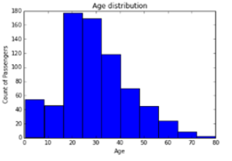
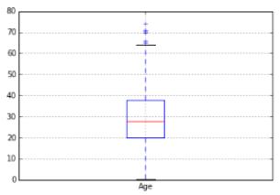
Distribution
It is commonly used at the initial stage of data exploration i.e. when we get started with understanding the variable. Variables are of two types: Continuous and Categorical. For continuous variable, we look at the centre, spread, outlier. For categorical variable we look at frequency table.
Histogram
It is used for showing the distribution of continuous variables.
Box-Plot
It is used to display full range of variation from min to max and useful to identify outlier values.

Slide 21
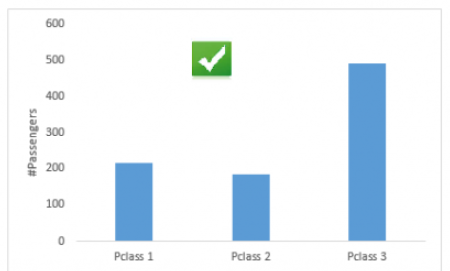
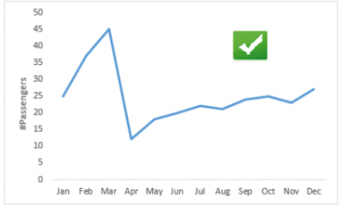
Comparison
It is used to compare values across different categories.
Common charts to represent these information are Bar and Line chart.
Bar Chart
It is used to compare values across different categories
Line Chart
It is used to compare values over quantitative variable.

Slide 22
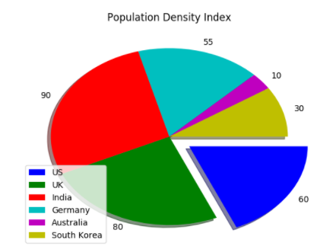
Composition
It is u.sed to show distribution of a variable across categories of another variable
Pie Chart
It can be created by passing the values representing each of the slices of the pie.

Slide 23
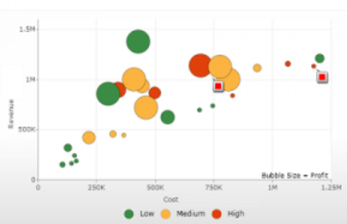
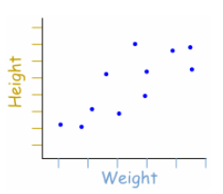
Relationship
It is widely used to understand the correlation between two or more continuous variables.
Scatter Plot
It clearly shows the relationship between two variables.

Slide 24
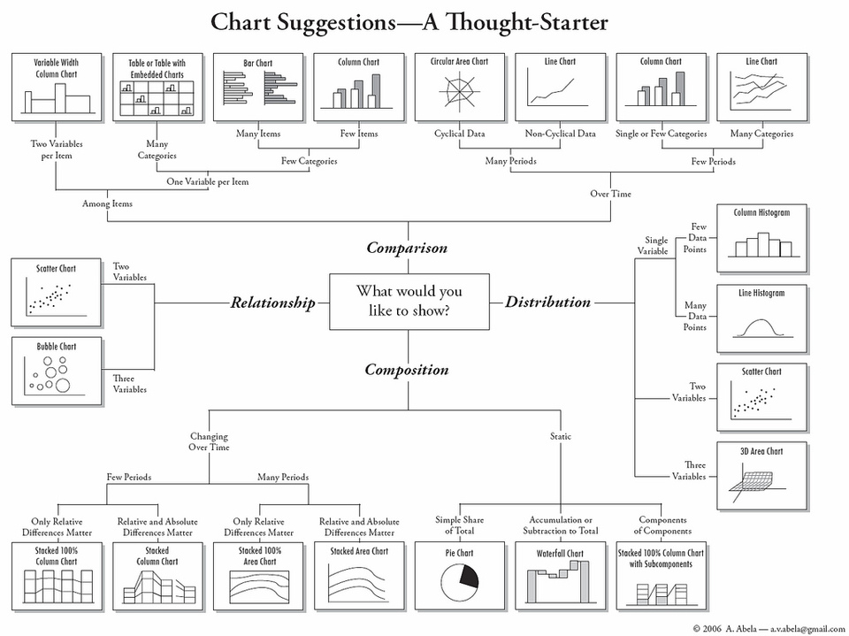

Slide 25
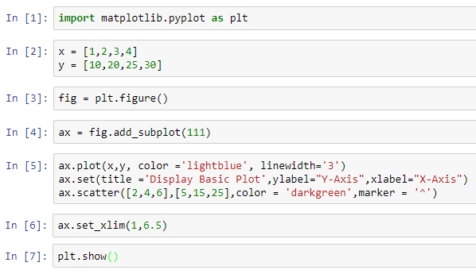
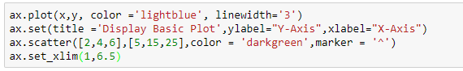
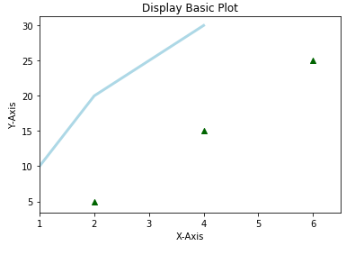
Workflow
The basic steps to creating plots with matplotlib are:
Load Matplotlib
Prepare Data
Plot
Create Plot
Customize Plot
Save Plot
Show Plot

Slide 26
Summary
Plotting data in the python ecosystem is a good news/bad news story.
Trying to figure out which ones works for you will depend on what you’re trying to accomplish.
there are a lot of options

Slide 27

Thank You

